Slide 1
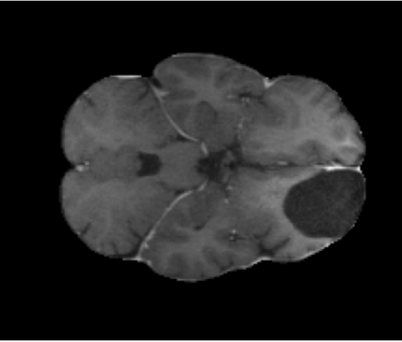
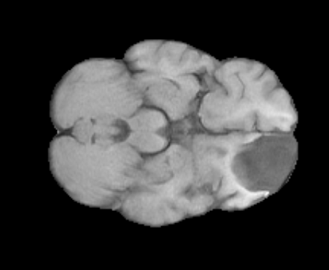
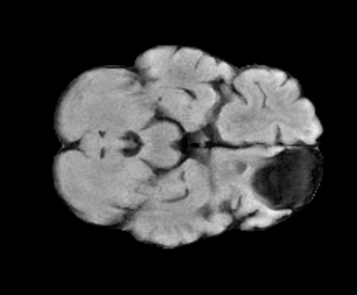
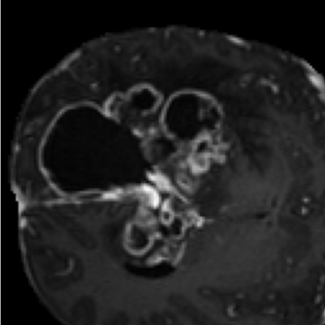
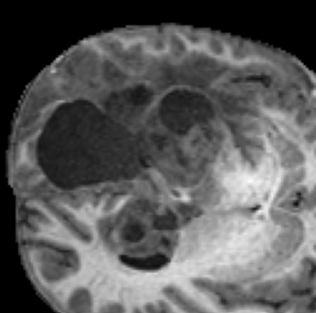
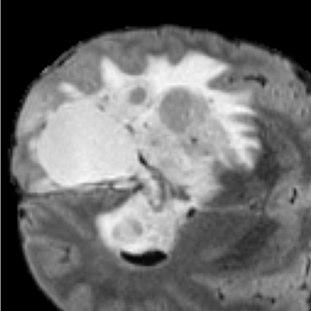
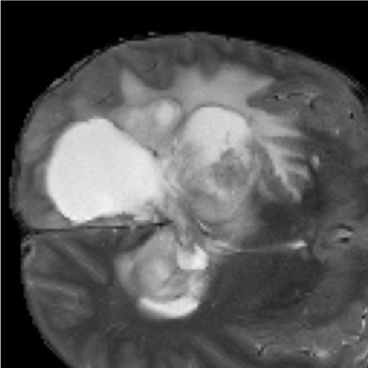
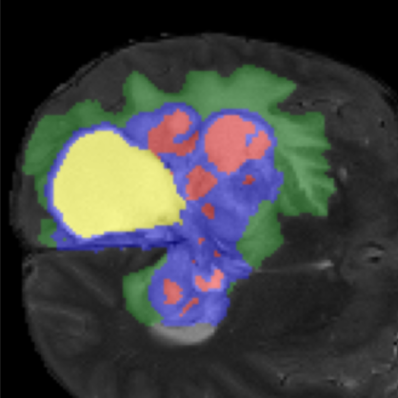
Multi-Parametric MRI (Full 3D Volumes)
T1c
T1n
T2f
T2w
Input Volume
Input Volume
Input Volume
Input Volume
Encoder
Conv3D + IN + GELU
Global Pooling
Multi-Scale Gated ABMIL
E1
(16)
Global Polling of E1-E4
Gated Attention Weighting
Context Vector z
Un-Supervised Tumor-Centered Patch Extraction
Preserve complete tumor context
E2
Conv3D + IN + GELU
Global Pooling
FiLM Bottleneck Conditioning
(32)
E1
E2
E3
E4
Tumor-Centered 3D Volumes (All Modalities)
γ(z), β(z)
β' = γ ⊙B + β'
Bottleneck 256 channels
E3
Conv3D + IN + GELU
Global Pooling
(64)
X
z
T1c
T1n
T2f
T2w
Global Pooling
“Channels” refers to the number of feature channels (feature maps).
Input Volume
Input Volume
Input Volume
Input Volume
E4
Conv3D + IN + GELU
(128)
Tumor-Centered 3D Volumes (All Modalities)
Attention Gate
Decoder Level 4
Input Patch (128 x 128 x 128 x 4)
Attention Gate (E4, z)
Concatenation + Upsample
1 x 1 x 1 Conv + Softmax
Attention Gate
Decoder Level 3
5 - Class Glioma Segmentation
Attention Gate (E3, z)
Concatenation + Upsample
Non Enhancing Tumor Core (NETC)
Enhancig Tissue (ET)
Decoder Level 2
Surrounding Non Flair Hyperintensity (SNFH)
Attention Gate
Attention Gate (E2, z)
Concatenation + Upsample
Resection Cavity (RC)
Attention Gate
Decoder Level 1
Attention Gate (E1, z)
Concatenation + Upsample

